Slide 1
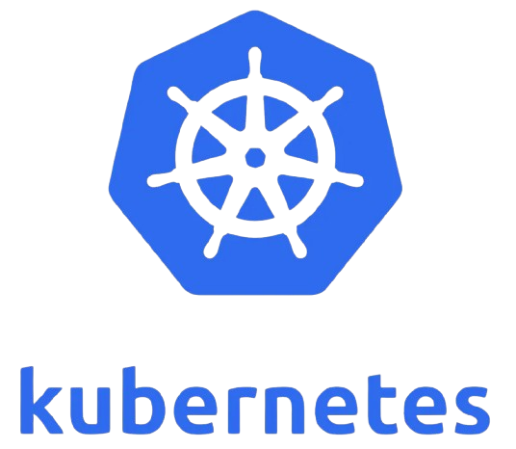
Kubernetes essentials
Robert danciu & robert balint Nov 19th
Notes:
B:
Hello everyone, and welcome to our workshop on Kubernetes Essentials.
Me and Robert are going to walk you through what Kubernetes is, why it exists, and how you can start using it effectively.
By the end, you’ll understand both the high-level concepts and practical reasons for using Kubernetes in modern application environments.

Slide 2
Agenda
Introduction
Background and origins
Why is it still relevant?
Comparison with alternatives
Core concepts & architecture
Kubernetes in action
Getting started
When (and when not) to use it
Resources & next steps
Notes:
B:
Here’s what we’ll cover today.
We’ll start with an introduction to Kubernetes—where it came from and why it was created.
Then we’ll look at why it remains relevant, compare it with alternative tools, explore its architecture and core concepts, walk through how Kubernetes works in practice, and discuss when you should or shouldn’t use it.
After talking about Kubernetes, we prepared some exercises that will help you better understand how it works.

Slide 3
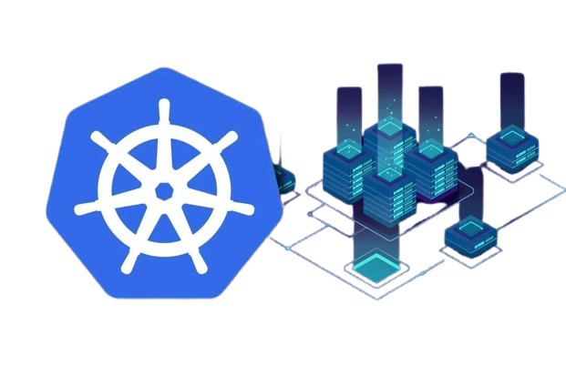
Why Kubernetes?
Containers offer portability, isolation, and efficiency
Growing container adoption requires orchestration
Kubernetes automates deployment, scaling, and management
Declarative model ensures desired state is maintained
Notes:
D:
Kubernetes exists because containers became extremely popular—they’re portable, isolated, and efficient.
But as organizations started running hundreds or thousands of containers, managing them manually quickly became impossible.
Kubernetes automates deployment, scaling, and management using a declarative model.
That means you describe the state you want, and Kubernetes constantly works to make sure the system matches that state.

Slide 4
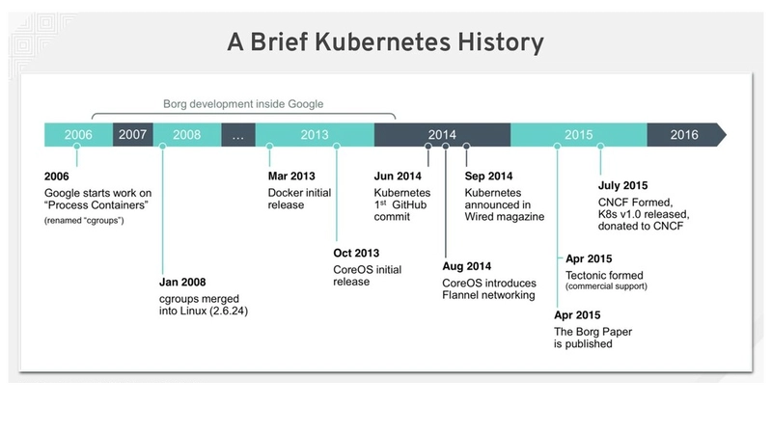
Origins of kubernetes
Developed at Google (2013), inspired by Borg and Omega
Open-sourced and donated to CNCF in 2015
Designed for on-premises, hybrid and cloud environments
Figure 1: Kubernetes history
Notes:
B:
Kubernetes was developed at Google around 2013, based on internal systems like Borg and Omega.
These systems had already been running massive distributed workloads for years.
Google open-sourced Kubernetes in 2014 and donated it to the CNCF in 2015, which helped it grow into a cloud-agnostic, community-driven platform that works on-premises, in hybrid setups, and in public clouds.
This diagram gives a visual timeline of Kubernetes’ evolution—from its early Google roots to where it is today as one of the most widely adopted cloud-native technologies.

Slide 5
Challenges Kubernetes solves
Problem | Kubernetes Solution
Managing hundreds of containers manually | Automated scheduling and placement of containers
Application failures | Self-healing, auto-restarts and rescheduling
Inconsistent deployments | Declarative configuration and versioned deployments
Risky updates | Rolling updates and instant rollbacks
Scaling issues under load | Horizontal, vertical, and cluster autoscaling
Service connectivity issues | Stable networking, DNS, and load balancing
Cloud portability challenges | Vendor-neutral API for hybrid / multi-cloud
Table 1: Kubernetes problem-solution
Notes:
D:
Kubernetes addresses a set of core operational challenges.
It automates container scheduling so workloads are placed efficiently.
It provides self-healing, so failed containers restart automatically.
It standardizes deployments using declarative YAML files.
It supports rolling updates and instant rollbacks, making deployments safer.
And it handles service discovery, networking, and scaling automatically.
In short: it turns complex distributed operations into predictable, automated processes.

Slide 6
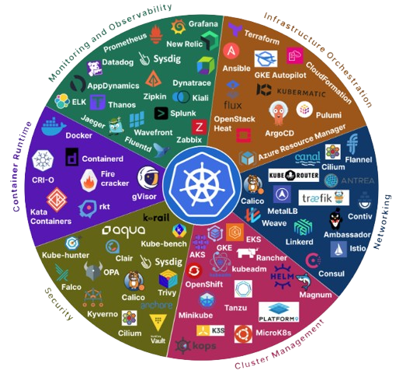
Why is it still relevant?
Dominant container orchestration platform
Large ecosystem and community support
Open-source, flexible, ad extensible
Hybrid and multi-cloud portability
Continually evolving with new features (Knative, Kubeflow)
Figure 2: Kubernetes ecosystem
Notes:
B:
Kubernetes remains relevant because it dominates the container orchestration ecosystem.
It has a huge community, major vendor support, and a massive ecosystem of plugins and tools.
It's open-source and extremely flexible.
It also works consistently across multi-cloud and hybrid environments.
And the ecosystem keeps evolving—tools like Knative and Kubeflow show how Kubernetes continues expanding into serverless and machine learning workloads.
This diagram gives you a sense of the enormous ecosystem around Kubernetes—covering networking, storage, CI/CD, observability, and more.
This ecosystem is one reason Kubernetes remains the industry standard.

Slide 7
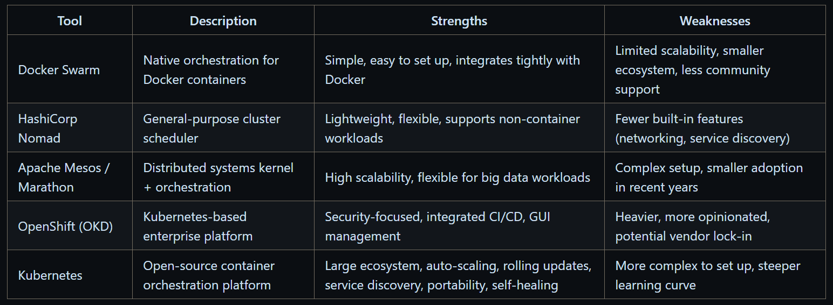
Alternative tools
Table 2: Comparison with other tools
Notes:
D:
Even though Kubernetes is dominant, there are alternatives.
Docker Swarm is simple but doesn't scale as well.
Nomad is lightweight and supports more workload types but has fewer built-in features.
Mesos was popular for big data workloads but has declined in adoption.
OpenShift adds enterprise features on top of Kubernetes but can be heavy and opinionated.
This comparison gives you a sense of the trade-offs.

Slide 8
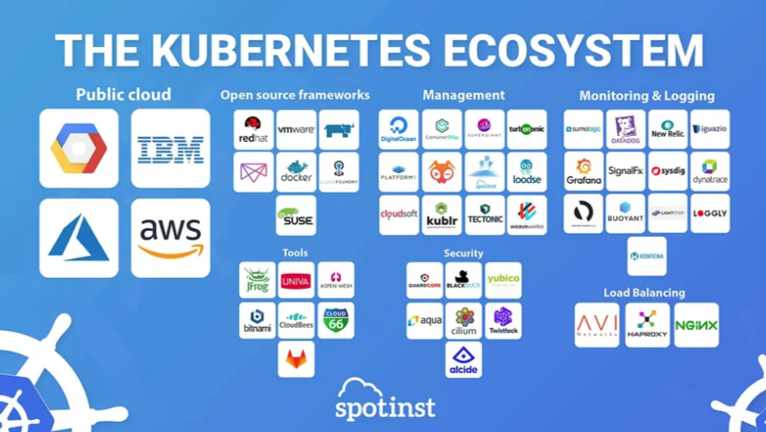
Why Kubernetes stands out?
Largest community and ecosystem
High scalability for thousands of nodes
Built-in features: auto-scaling, rolling updates, service discovery
Portability across on-prem, public, hybrid clouds
Figure 3: Kubernetes ecosystem
Notes:
B:
Kubernetes stands out because of its massive community, unmatched scalability, and rich set of built-in features like rolling updates, service discovery, and auto-scaling.
It also runs almost anywhere—on-prem, in the cloud, or across multiple clouds—making it extremely portable
This is another view of the Kubernetes ecosystem, showing just how broad and mature the tooling landscape is.
This maturity is a major factor in Kubernetes’ success.

Slide 9
Choosing kubernetes
Powerful but not always necessary
Its adoption depends on application complexity, scaling needs, team expertise and infrastructure resources
When to use | When not to use
Microservice architecture with multiple, loosely coupled services | Monolithic applications with simple deployment requirements
Applications requiring high availability and dynamic scaling | Low-traffic or single-instance applications
CI/CD pipelines with frequent deployments | Teams with limited DevOps expertise or operational resources
Multi-cloud or hybrid-cloud deployments requiring portability | Projects with constrained infrastructure or strict simplicity requirements
Workloads that benefit from self-healing, automated scaling and rolling updated | Serverless or PaaS environments where orchestration is handled by the platform
Table 3: When (and when not) to use Kubernetes
Notes:
D:
Kubernetes is powerful, but it’s not always the right choice.
It shines in complex, distributed systems—especially microservices.
But for small applications, low traffic, or teams without DevOps expertise, Kubernetes may add unnecessary complexity.
It’s important to weigh the benefits against the operational overhead.
This table summarizes when Kubernetes makes sense:
Use it for microservices, high-availability systems, frequent deployments, and hybrid/multi-cloud environments.
Avoid it for simple monolithic apps, single-instance deployments, small teams without Kubernetes experience, or projects where a simpler PaaS or serverless platform is enough.

Slide 10
How Kubernetes work?
Control plane:
API Server: manages communication
Etcd: manages the configuration data, state data and metadata
Scheduler: assigns new Pods to Nodes
Controller Manager: runs multiple control loops that watch the cluster’s state
Worker nodes:
kubelet: makes sure containers are running and healthy
container runtime: manages the execution and lifecycle of containers
kube-proxy: ensures incoming traffic is distributed evenly among the pods
Desired state model:
Continuously reconciles actual vs desired state
Notes:
B:
Here’s a quick breakdown of the Kubernetes architecture.
The control plane is the brain—it includes the API server, etcd for storing cluster state, the scheduler, and various controllers.
Worker nodes actually run your applications.
Each node has a kubelet, a container runtime like containerd, and kube-proxy for networking.
Together, these components coordinate to keep the cluster up and running.

Slide 11
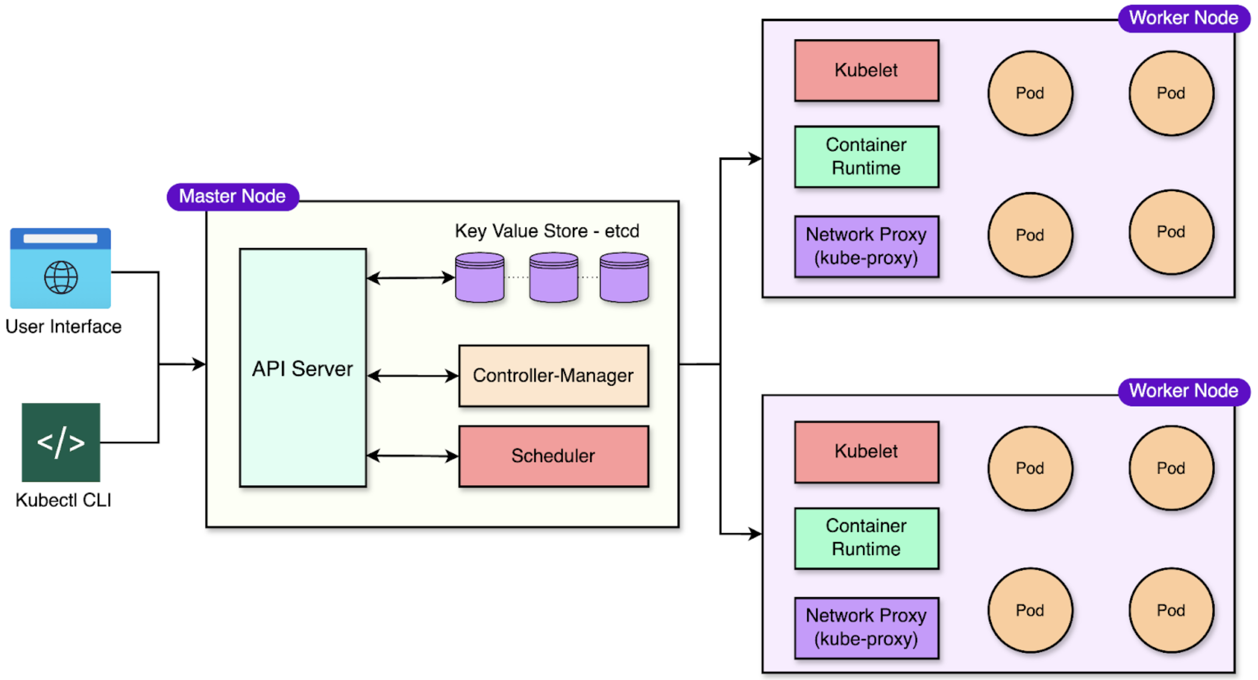
Kubernetes architecture
Figure 4: Kubernetes architecture
Notes:
B:
This diagram visualizes everything we just covered—control plane components at the top and worker nodes below.
It helps you understand how Kubernetes decides where to run applications and how it maintains the desired state.

Slide 12
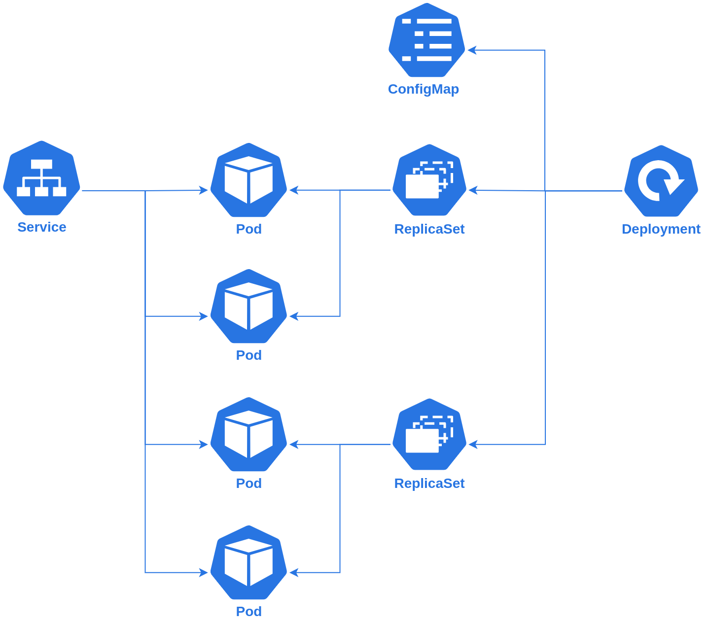
Core kubernetes concepts
Pods: Smallest deployable unit
Deployments: Manage replicas and updates
ReplicaSets: Maintain desired pod count
Services & Ingress: Networking & access
ConfigMaps & Secrets: Configuration and sensitive data
PersistentVolumes & Claims: Persistent storage
Figure 5: Kubernetes flowchart
Notes:
D:
Kubernetes introduces several key abstractions.
Pods are the smallest deployable units.
ReplicaSets ensure a certain number of pods are always running.
Deployments manage updates over time.
Services provide networking and stable access points.
ConfigMaps and Secrets store configuration.
PersistentVolumes handle storage.
Understanding these abstractions is essential to working with Kubernetes.
This flowchart shows how requests and objects flow through Kubernetes—from definitions in YAML, through the API server, controllers, scheduler, and finally the nodes that run the containers.

Slide 13
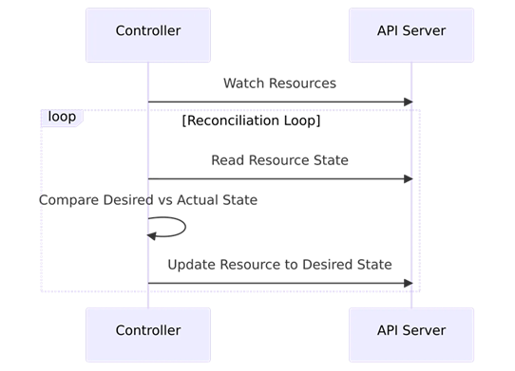
Maintaining desired state
Reconciliation loop:
User defines YAML manifest
API Server stores state in etcd
Controllers detect differences
Scheduler assigns pods, kubelet monitors
Loop repeats until desired state matches
Notes:
B:
Kubernetes constantly compares the actual state of the cluster to the desired state defined by the user.
This is known as reconciliation.
If a pod crashes, it gets restarted.
If a node fails, pods are moved.
If you change your YAML and apply it, Kubernetes updates the system automatically.
This loop is the foundation of Kubernetes reliability.

Slide 14
Getting started
Notes:
Practical

Slide 15
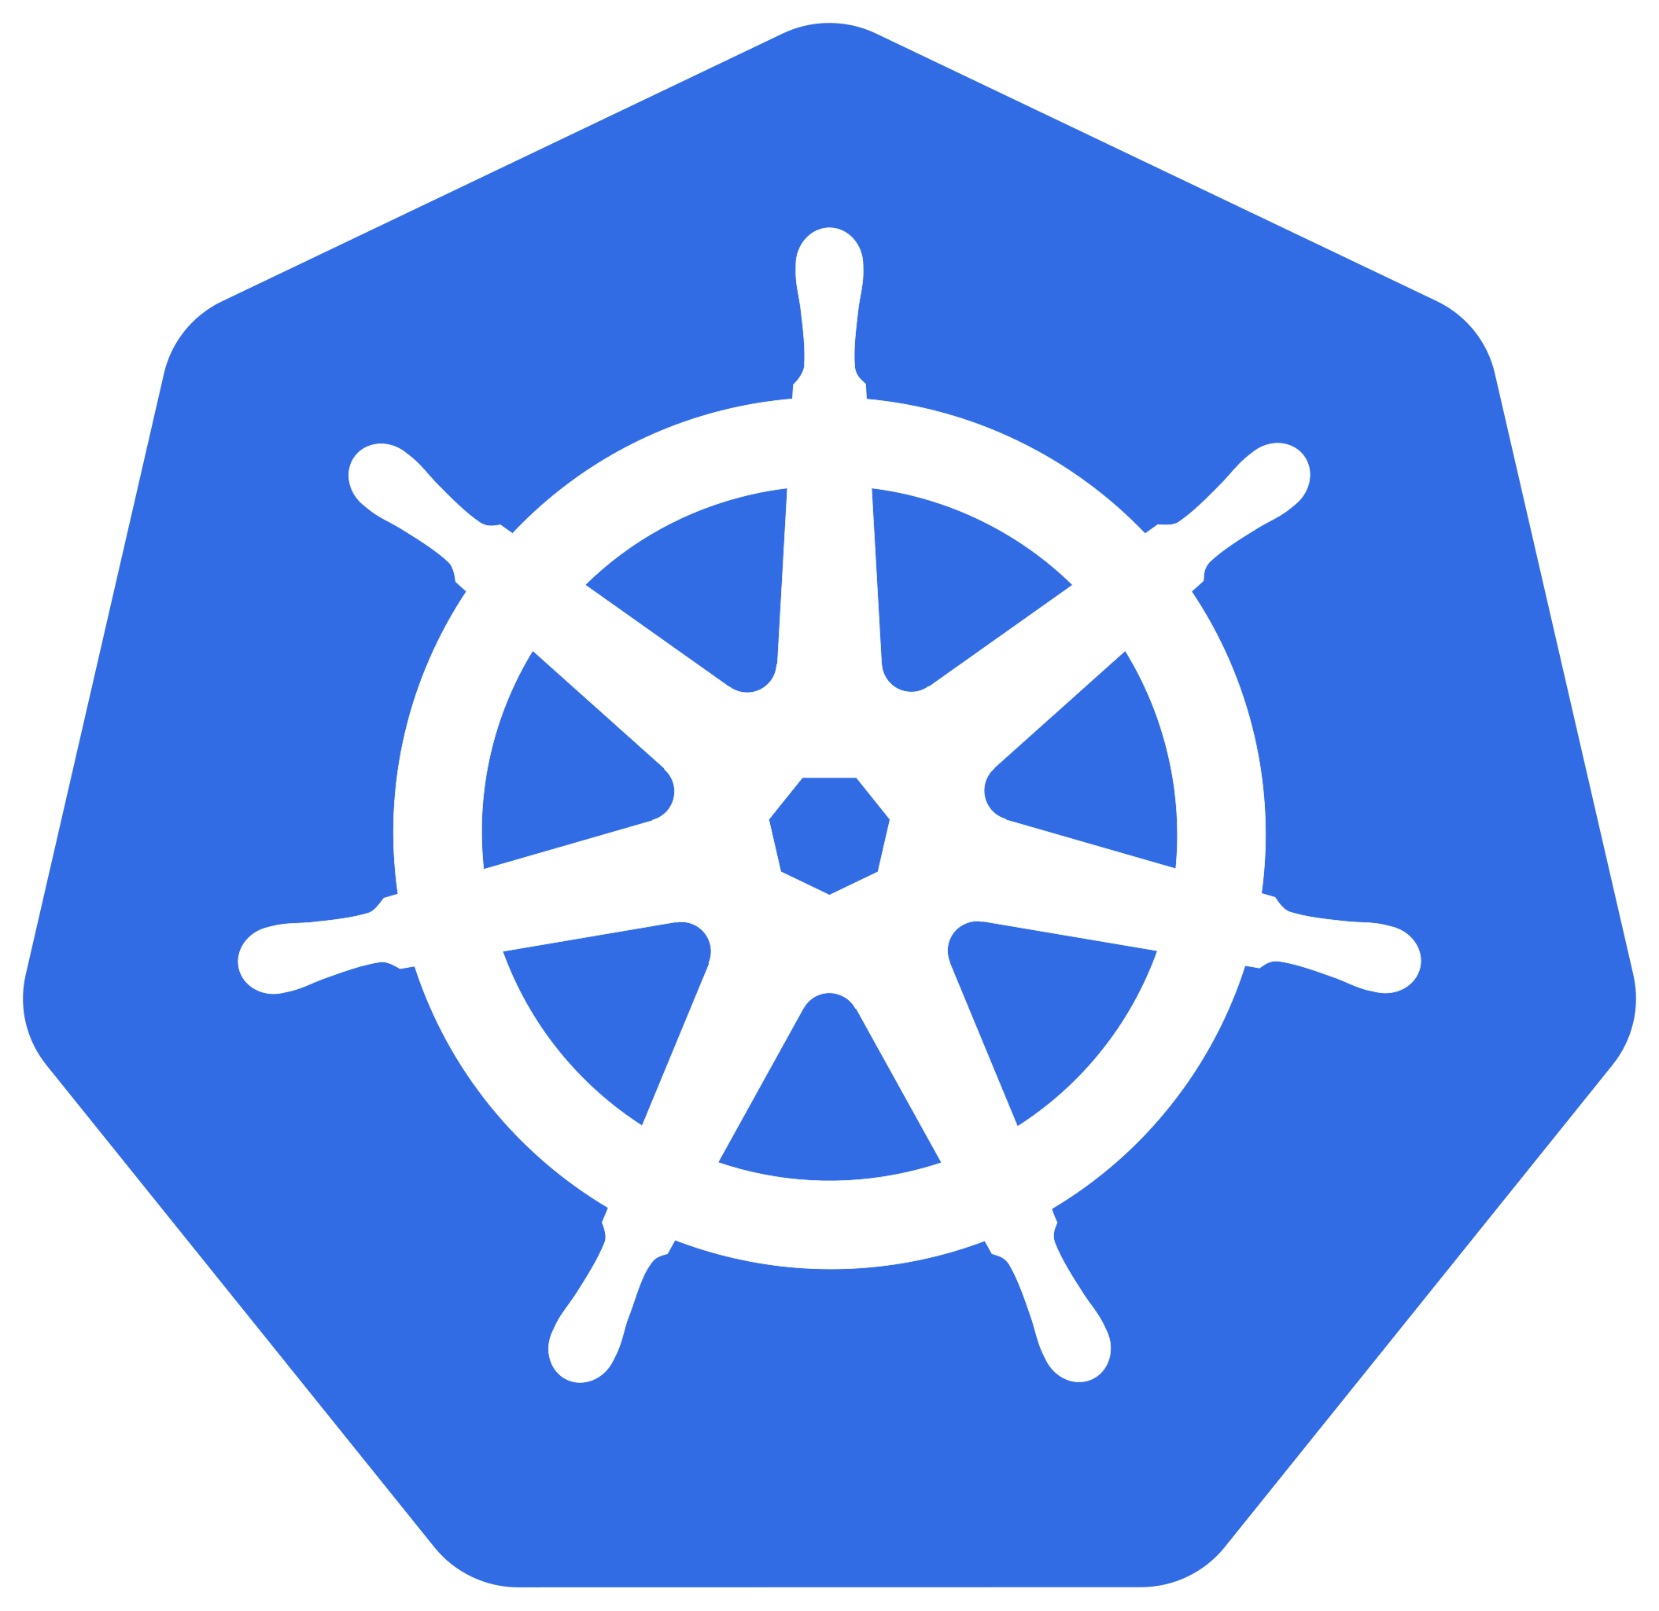
Resources
Official Kubernetes docs: https://kubernetes.io/docs/home/
Interactive tutorials: Katacoda
Books: Kubernetes Up & Running (Hightower et al.)
CNCF reports and community blogs
Notes:
Here are some recommended resources to continue learning.
The official Kubernetes documentation is excellent.
Interactive tutorials like Katacoda help you practice hands-on.
The book Kubernetes Up & Running is a great deep dive.
And CNCF community blogs and reports help you stay up-to-date with new features.

Slide 16
THANK YOU

